Slide 1
Automated Registration Process for 2019 Innovation Drive & Technology Expo

Slide 2
Background : What is IDTE?
The Innovation Drive & Technology Expo (IDTE) is a yearly event held by Ford Motor Company.
The event is attended by approximately 1000 attendees made up of three groups:
Group 1: Presenters, Ford employees presenting the technologies
Group 2:Technology partners from outside Ford Motor Company
Supplier
University
Start-up company
Group 3: Evaluators, represented by senior management who evaluate the presented technologies
Unlike other exhibitions, this is a 1:1 presentation and hands on experience of new technologies.
Highlights from last year’s event held in Lommel Belgium

Slide 3
Background (Cont’d)
This year’s event is being held in Europe, in Lommel, Belgium.
Tentative Dates
Setup: September 18-20
Dry-Run: September 23
Final prep: September 24
Event: Sept. 25-27 & Sept. 30 – Oct. 1
Teardown: October 2
Current and past registration processes have been conducted manually.

Slide 4
Project Scope: Automated Registration Process
Build an online registration process tailored for each group.
The registration process can be completed via a website or a mobile phone (app or mobile-optimized browser for both iOS and Android).
The online registration process should include the following:
Prior to the event
Automated invitation letter sent out by email
Attendee registers online
Every attendee is assigned a QR code
Attendee receives confirmation email with the QR code
Attendee has the opportunity to update information
Database maintained by designated administrators
During the event
QR code is scanned to generate a badge with Name, Title, Company, QR code
Badge QR code is scanned on successive days to check in attendee
Post event
Send out survey questions by email
Link survey results to the database
Automated summary of survey results

Slide 5
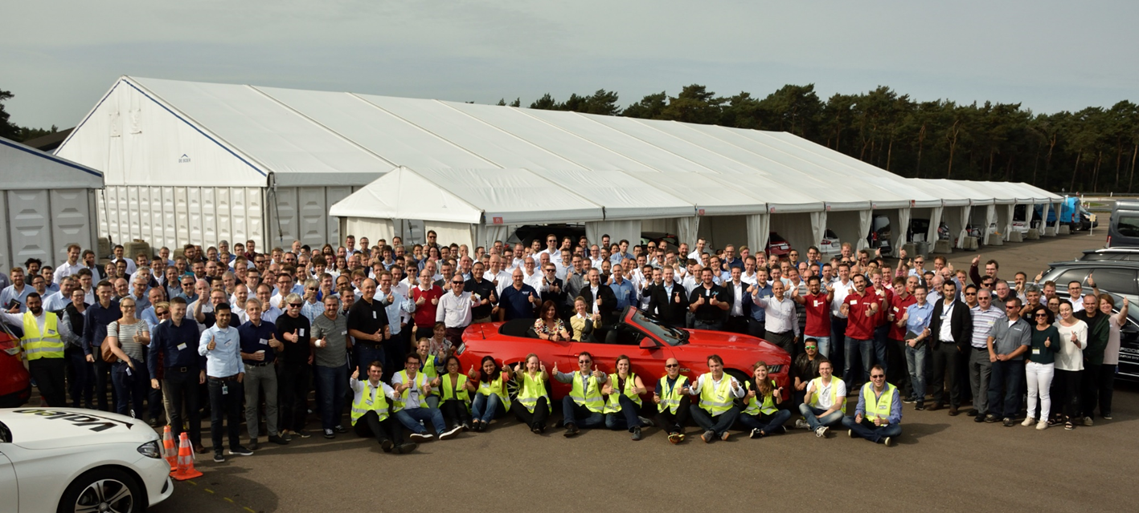
Backup Slides

Slide 6

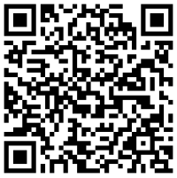
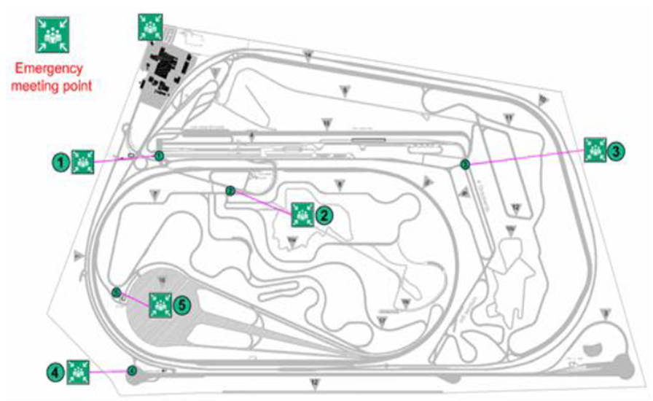
Jamel
Jamel Belwafa
FORD MOTOR COMPANY
DEARBORN, UNITED STATES
Mandatory Daily Briefing Meeting
9:00 AM @ Walter’s ???
In case of emergency
Call: 555-555-5555
WHAT TO DO IN CASE OF ALARM?
SIGNAL: Alarm signal – Radio message: “Evacuation, drive to the nearest meeting point”
ACTION: Stop all demos immediately and proceed safely to the first emergency meeting point
August 22-28, 2018
TBD, Michigan
EVALUATOR
PRESENTER
SUPPLIER
University
22 23 24 27 28
Startup
COORDINATOR

Slide 7
SUPPLIER ACCESS

Slide 8
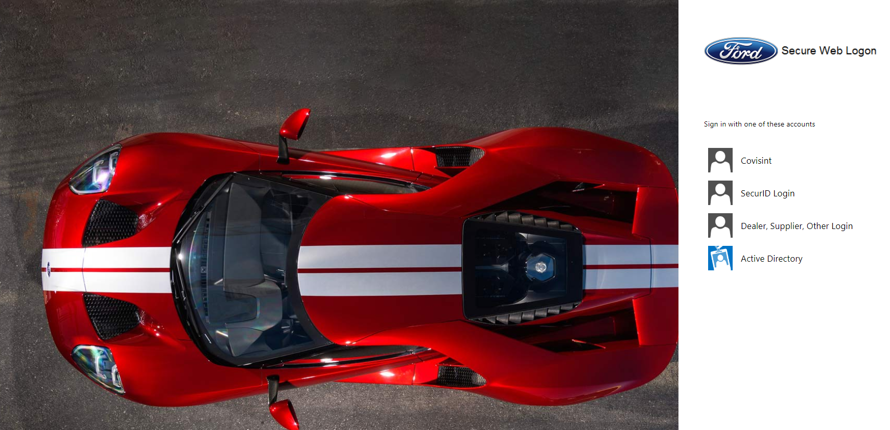
Supplier will click on this icon to login

Slide 9
Website Arrangement For Supplier
Idea Submission
Now Open
Registration
Opens on April 15, 2019
Important Event Information & Q/A
Map/Direction
to IDTE Event
CLICK HERE
CLICK HERE
Display Layout
IDTE Team
Contact List

Slide 10
FORD EMPLOYEES ACCESS

Slide 11
Ford employees will click on this icon to login

Slide 12
Website Arrangement for Ford email
Idea Submission
Now Open
Registration
Opens on April 15, 2019
Important Event Information & Q/A
Map/Direction
to IDTE Event
EVALUATOR
Click Here
Display Layout
CLICK HERE
Presenter/Supporter
Click Here
IDTE Team
Contact List

Slide 13
Event Overview/Information & Q/A
Purpose: Showcasing customer relevant technologies and provide our Ford Executive teams an opportunity to experience and evaluate new and relevant technologies.
Key Event Members:
Evaluators: invited senior management level Ford employees from around the globe to evaluate and experience
Presenters: are Ford subject matter experts (SMEs) presenting the technologies.
Suppliers: are supplier SMEs providing technical background for their technologies.
Experience: Evaluators are given a personalized agenda. Each technology is experienced in a 20 minute demonstration. This may be in a vehicle testing new electrified solutions, a new self-parking feature, or inside experiencing a virtual mobility solution, or watching a new 3D Printing concept in action.
After each experience, a questionnaire is completed, providing feedback on the technology.
For all technologies, Ford presenters will give a brief talk and demonstration to the participant. Supplier representatives will support for more technical details for their technologies.
DRAFT – TO BE UPDATED

Slide 14
Event Overview/Information & Q/A
Who presents supplier technology demos (including statics & drivables)?
A Ford Presenter. The supplier Representative will support and help answer questions.
Who drives the drivable technologies?
The Evaluator drives the vehicle to experience the technology (a few exceptions).
Who rides in the passenger seat in a supplier drivable technology?
The Ford Presenter who will be giving the presentation and is informed on the safety protocols on the test track. The supplier Representative will ride in the vehicle to provide support to the Ford Presenter.
When do we find out who we are presenting to?
Supporters will receive an agenda with their Evaluator information each morning at the supporter briefing.
Are Suppliers allowed to look at all the other technologies?
No, due to confidentiality and security reasons, this will not be permitted.
Each supporter will have identifiers on their name badge as to Ford vs. Supplier.
Will Ford Intranet be available and only for demos
There will be limited availability. Please communicate your needs via the SharePoint request form, and consult with your central planner.

Slide 15
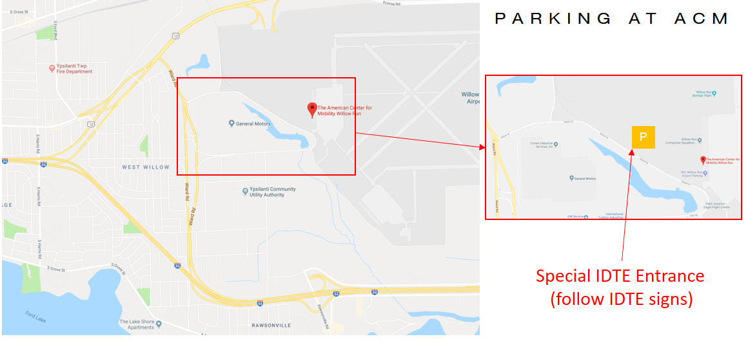
Map/Direction to IDTE Event
DRAFT – TO BE UPDATED

Slide 16
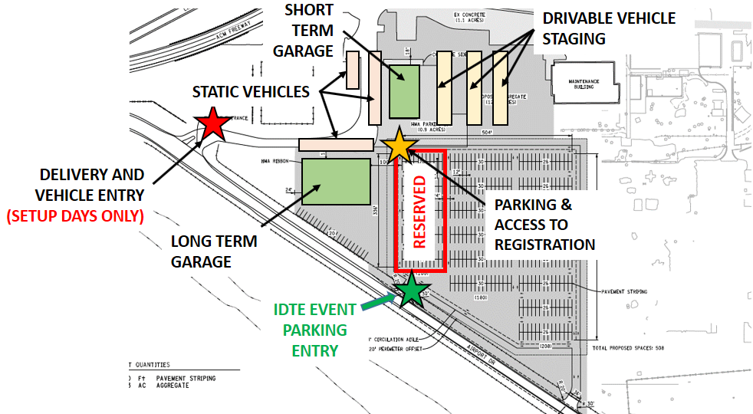
Map/Direction to IDTE Event
DRAFT – TO BE UPDATED

Slide 17
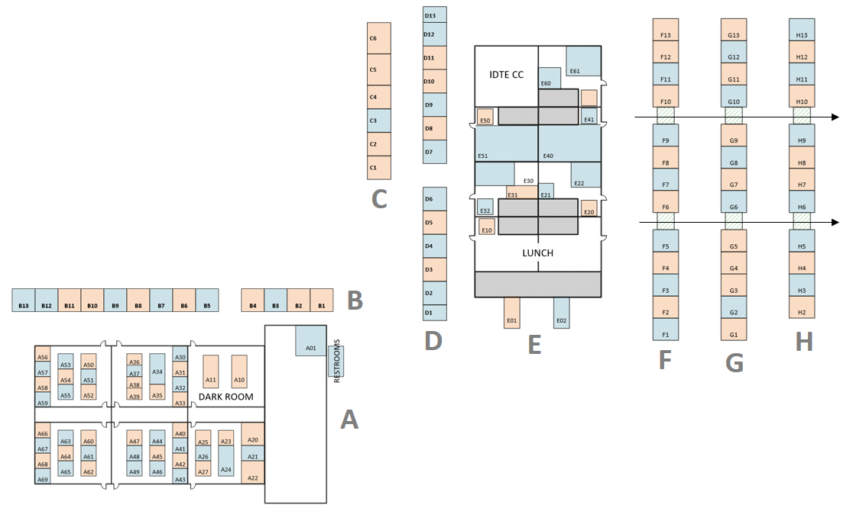
Display Layout
DRAFT – TO BE UPDATED

Slide 18
IDTE Team Contact List
Walter Pijles
Donna Thomas
.
.
.
IDTE email
DRAFT – TO BE UPDATED

Slide 19
IDEA SUBMISSION
Initial invitation email to Suppliers & Ford
Supplier Idea Submission
Short Descriptive Title
Project Description
Strategic Imperative
Main supplier point of contact with IDTE team (name, email, phone #)
Demo type:
Driving vehicle
Static vehicle
Static display
Display hardware coming from what city/country?
Ford Idea Submission
Short Descriptive Title
Project Description
Main point of contact with IDTE team (name, email, phone #)
Demo type:
Driving vehicle
Static vehicle
Static display
Information fed to database
Assign Facilitator
& Management for ranking
Management Ranking
Review with K. W.

Slide 20
PRE-REGISTRATION
Registration Information:
Digital signature for waiver and policy agreement (1st screen)
First Name
Last Name
Email address
Company Name, City, Country
Dates attending
Mobile Phone Number during event
Technology Number
Attendee Register Online
Information fed to database
Attendee receives email containing
Confirmation letter
Code to allow update of information
QR code to be scanned during registration (hardcopy/digital)
Attached outlook meeting reminder
Short Survey
Attendee receives reminder email two weeks prior to event

Slide 21
Ford Presenters & Suppliers
Evaluators
First Day Attendance
Future Days Attendance
Provide confirmation letter w/ QR Code
(hardcopy or digital)
Attendee provides confirmation letter w/ QR
(hardcopy or digital)
Badge get scanned
Confirmation gets scanned
Is attendee listed to attend?
Confirmation gets scanned
Support desk gets notified
Badge gets printed
Badge pre-printed at support desk or at registration?
N
Y
Obtain Badge
Same day
registration
Y
Enters Event
Camera Patches???
N
Attendance information fed to database and flagged in case of a change.

Slide 22
Can we have the site view and navigation similar to Excel based sites. Example:
Current SharePoint search is not good. Example: looking for a participant in the attendance list.
Send generic email with attachment option
Example of survey summary:
https://pd3.spt.ford.com/sites/InnovationAcceleration/Lists/PowerUp%20Talk%20%20Mobile%20App%20Development%20%20Publishing/summary.aspx

